Slide 1
Calculate Table
Calculate Table

Slide 2
Calculate Table
Note: This demonstration uses the AdventureWorks2016 database and more specifically the DimProduct and FactInternetSales tables .
Start by creating a measure that calculates the average amount of revenue generated corresponding to the product class "M" .
AVG Sales Class M =
CALCULATE (
AVERAGE ( FactInternetSales [ OrderQuantity ] ) * AVERAGE ( FactInternetSales [ UnitPrice ] ),
DimProduct [Class] = "M"
)

Slide 3
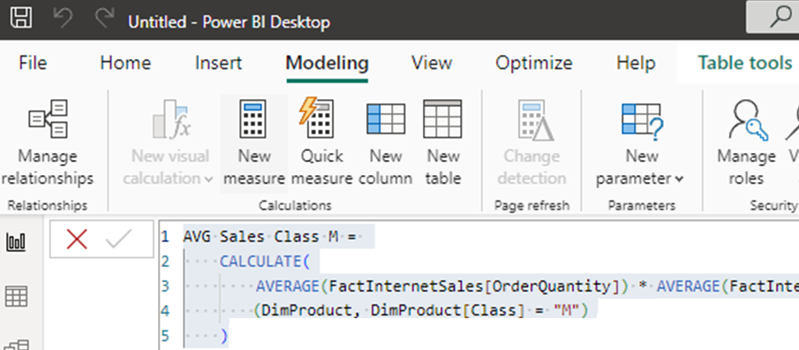
Calculate Table
In the Modeling tab, click New Table.

Slide 4
Calculate Table
Create a view of the DimProduct table that leaves only products with a tax value greater than 1.
DimProduct ( TaxAmt Greater than 1)= CALCULATETABLE ( DimProduct , FILTER ( FactInternetSales , FactInternetSales [ TaxAmt ] > 1 ))
Conclude that the Calculate function is used to calculate measures and calculated columns, while CalculateTable is used to create filtered views.

Slide 5
THANKS
THANKS

